Slide 1
ADVANCED PACKAGE REWORK
PUREX FUME EXTRACTION – PRODUCT OVERVIEW

Slide 2
Worldwide network of distributors and agents
Manufacturing ISO9001 compliant
20,000 sq/ft UK production facility
15,000 sq/ft US distribution warehouse and sales office
Over 30 years experience as a manufacturer in the business
Dedicated sales and technical support
Preferred supplier to many of the largest companies in the world
Approaching 1 million dollars in stock inventory (USA).

Slide 3
The need for Fume Extraction…
Many types of dust and fumes are hazardous to health if inhaled
People can become permanently sensitized to fumes by continued exposure causing asthma or other respiratory diseases
High performance fume extraction helps to…
Protect employee health
Increase production speeds
Reduce cost and time to clean equipment
Reduce product contamination

Slide 4
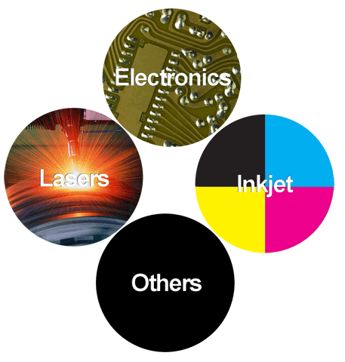
Markets
Coding & Marking
Lasers and CIJ Inkjet
Engraving
Desktop and industrial lasers
Electronics Soldering
Reflow, Wave, Curing
Assembly, Rework/Repair
Tinning/Potting
Robotic Soldering
Inkjet Printing
Wide format
Dye Sublimation
Others
Adhesives, Pharmaceutical, Medical Cleanroom, Welding, Wood dust etc.

Slide 5
Electronics Applications
Wave Soldering
Reflow Ovens
Component Underfill
Selective Soldering
Hand Soldering
Point to Point Soldering
Tip Extraction
Arm Extraction
Extraction Cabinets
Laser Soldering
Printing

Slide 6
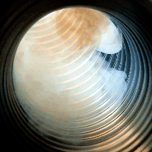
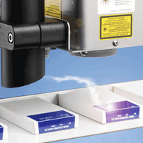
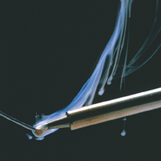
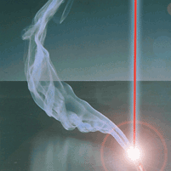
Where Are Fumes Produced?
Many industrial processes can generate harmful dust and fumes. Essentially any operation where a material is cut, marked, heated, burned or physically altered in any way has the potential to produce harmful materials.
Some common processes which produce harmful fumes:
Laser & Inkjet Coding
Laser Cutting/Etching
Printing
Hand & Machine Soldering
Pharmaceutical Manufacture
Laboratory & Cleanroom Work

Slide 7
What Are Fumes?
Depending on the process and the materials used a fume may contain:
Particles of various sizes
Vapor which can condense to form a liquid
Gases of various types
All of the above may be present in the fume in various concentrations depending on the process in question.
Particles
Vapor
Gas

Slide 8
Particle Size
Particles between 50µm and 10µm are filtered out by the nose.
Particles from 10µm to 7µm deposit on the mucous surface and are carried outwards by biological processes.
Particles between 7µm and 0.5µm deposit in the lungs. These are the particles that have the most potential for causing medical conditions such as occupational asthma.
Particles less than 0.5µm behave essentially as gases and can cause harm prior to exhalation.
50µm - 10µm
10µm - 7µm
7µm - 0.5µm
<0.5µm

Slide 9
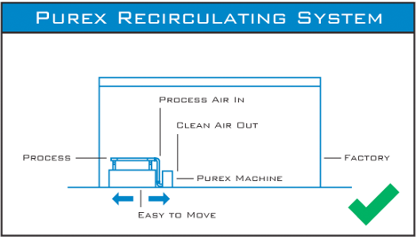
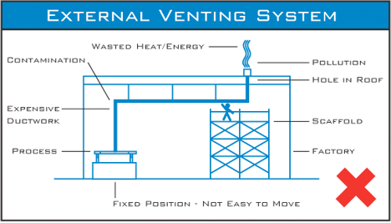
Extraction Systems
Two types of extraction systems available:
Internal – at source capture and filtration or LEV (local exhaust ventilation) system
External – exhausted contaminated air outside without filtration

Slide 10
Local Exhaust Ventilation Benefits
Safety:
Purex uses multi-stage filtration to remove harmful fumes and return clean air back to the working environment
Cost:
No modifications needed to the building
Fumes not properly handled lead to employee discomfort, increased healthcare costs, lost time at work and fines
Environment:
Unfiltered exhausted vapors are harmful, can re-enter the facility, and affect neighboring buildings
Consistency:
Purex equipment maintains a steady volume of air flow
Local Legislation:
Many local laws prevent exhausting of fumes to the outside
Flexibility
Purex Fume Extraction units are easy to move making the process more portable

Slide 11
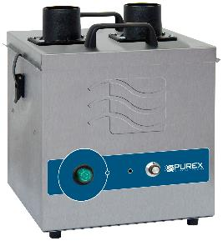
Analog Machines
Automatic Flow Control maintains constant extraction rate
Adjustable Air Flow extends filter life
Blocked Filter Warning
Easy to change filters
Quiet operation
Reverse Air Flow prevents condensation and extends filter life
Filter Blocked Monitor
Remote Machine Interface
Welded stainless steel construction
Continuous run brushless motors
Low energy consumption
HEPA filtration removes 99.997% of particles down to .3 microns

Slide 12
Analog Machines
Power Switch with Indicator Light
Variable Speed Control
Filter Status Indicator
Click here to view the Fume Extraction Selector Guide

Slide 13
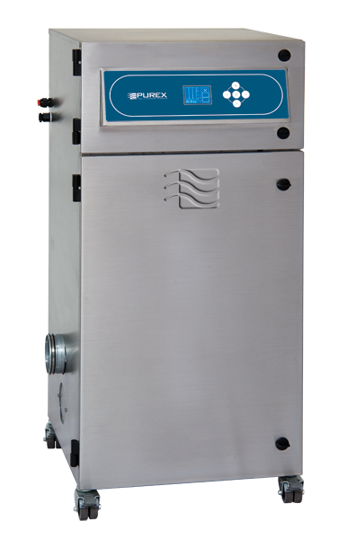
Digital Machines
Automatic Flow Control maintains constant extraction rate
Adjustable Air Flow extends filter life
Blocked Filter Warning
Easy to change filters
Low energy consumption
Quiet operation
Welded stainless steel construction
Reverse Air Flow prevents condensation and extends filter life
Continuous run brushless motors
HEPA filtration removes 99.997% of particles down to .3 microns
Gas and particle sensors on exhaust
Filter Blocked Monitor
Gas Safety Sensor
Particle Safety Sensor
Motor Run Indicator
Airflow reading
Filtered air temperature
Quick-read visual display
Remote Machine Interface

Slide 14
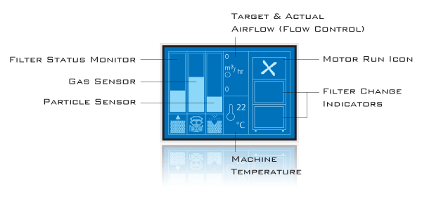
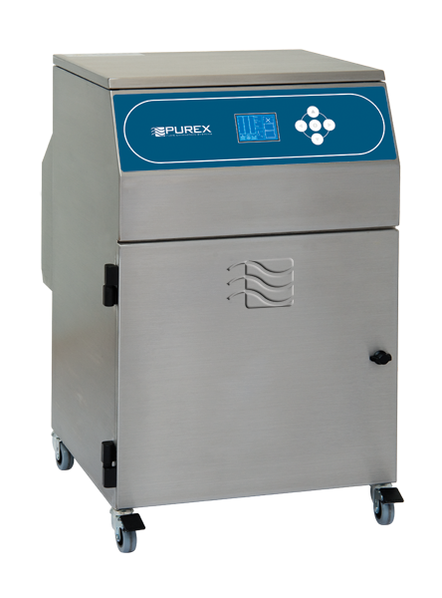
Digital Machines
Informative Visual Display
Click here to view the Fume Extraction Selector Guide

Slide 15
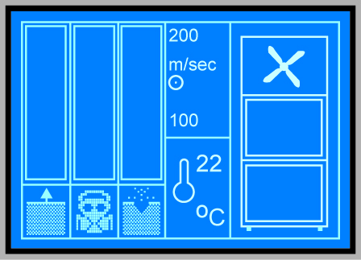
Blocked Filter Sensor
Fume generated by the process will slowly block the particle filter over time.
When the particle filter is nearly blocked the fume extractors will warn the operator with an audible chime and the keypad will flash red.
This feature allows the operator time to acquire a replacement particle filter before the current one becomes completely blocked.
When the particle filter is completely blocked then the fume extractors will chime and the keypad will flash every second. At this point the filter sensor icon will flash to show which filters may need attention.
Filter Sensor Icon

Slide 16
Gas Sensor
Purex 'Digital' fume extractors incorporate a gas sensor in the exhaust to protect workers. The sensor helps ensure that gas from the process cannot pass through the extractor, into the workplace without an alarm being triggered.
A gas escape may occur if:
Filters are saturated
Filters are damaged or missing
A seal is damaged
The wrong filter has been used
The sensor is also used to warn the operator when the chemical filter needs replacing.
Gas Sensor Icon

Slide 17
Particle Sensor
Purex digital fume extractors incorporate a particle sensor in the exhaust to protect workers.
The sensor helps ensure that particles from the process cannot pass through the extractor, into the workplace without an alarm being triggered.
Particle escape may occur if:
Filters are damaged or missing
A seal is damaged
The wrong filter has been used
Particle Sensor Icon

Slide 18
Temperature Sensor
A safety feature to warn the operator if the fume extractor overheats.
Cut out at 65°C to protect motor and system
Note thermal interrupt will probably occur in blower motor prior to this and result in a blocked filter alarm.
Temperature Sensor

Slide 19
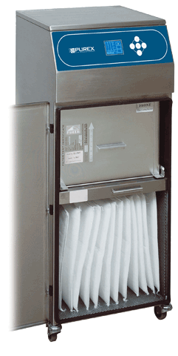
Purex Filtration Process
3 Stage Filtration Particles/Dust are filtered by:
1 - Pre-filters
2 - HEPA filters
Gas / Vapor are filtered by:
3 - Activated Carbon (Alkali or Acid impregnated)
Option – Alumina Permanganate
Option - Other special blends of filter media
Main Filter captures small particles and/or gas
Pre-Filter captures large particles
Example - 400i

Slide 20
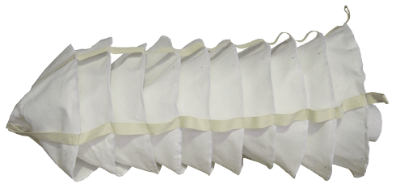
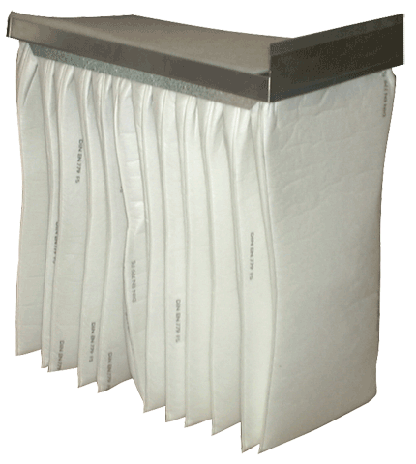
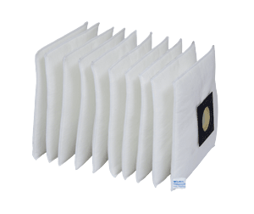
Pre-Filters
Pre-filters are used to remove coarse particles from the airstream. Helps to extend the life of the Main Filter. Standard filtration efficiencies are listed in En779.
Rating | Efficiency | Particle Size (Mu)
F9 | >95% | 0.5 - 1
F8 | 90 to 95% | 1 - 3
F7 | 80 to 90% | 1 - 3
F6 | 60 to 80% | 1 - 3
F5 | 40 to 60% | 3 - 5

Slide 21
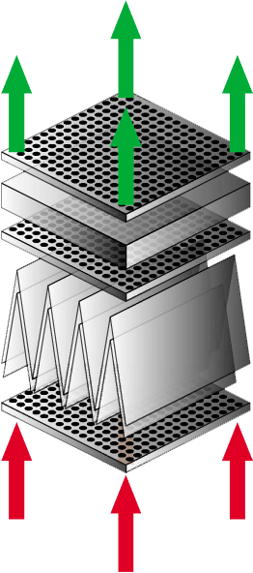
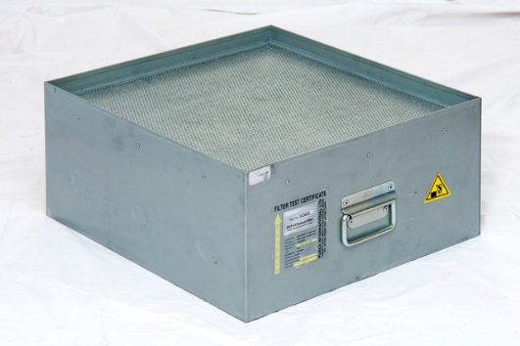
Main Filter Construction
Purified air out
Air equalization
plates ensure even airflow through the chemical layer
Chemical layer
Reinforced HEPA
element
Contaminated Airflow in

Slide 22
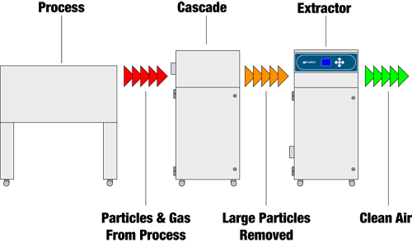
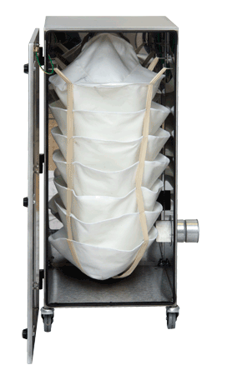
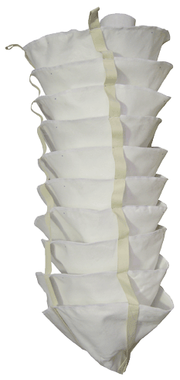
Cascade Inline Filter
Cascade bags are used as an additional inline filter in very heavy dust applications or where sticky problematic materials are being processed e.g. rubber

Slide 23
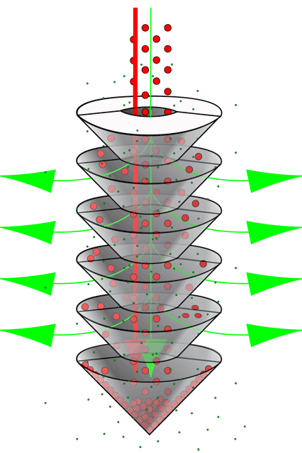
Cascade Inline Filter
Cascade prolongs the life of the filters in the machine
It also can be seeded so particles can be shaken off the filter to further prolong life
Large and Small particles from process
Large Particles are held in the Cascade
Small Particles go on to be filtered by the machine

Slide 24
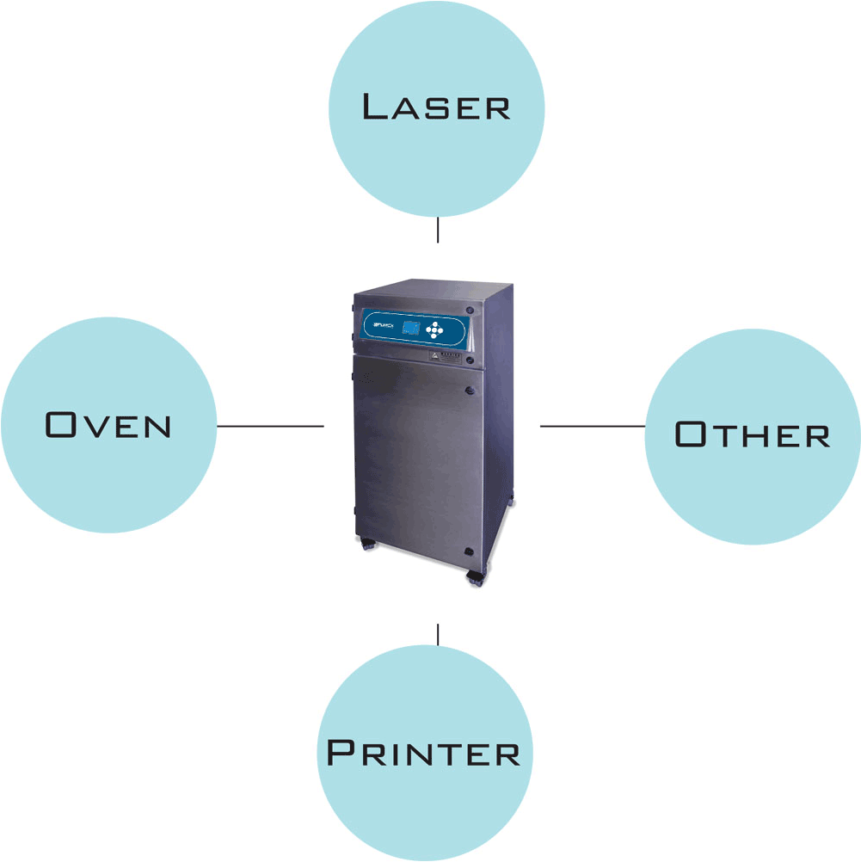
Interfacing
The fume extractors alarm signal can be interfaced with other equipment such as a laser or wave soldering machine to stop the process, set off an alarm or perform another function such as turning on a beacon. Alarm signals can include:
Filter blocked
Gas alarm
Particle alarm
The fume extractors can also STOP/START automatically with interfaced machines. A run on timer is also available to ensure dust and fume is extracted after the process stops.

Slide 25
Machine Interfacing

Slide 26
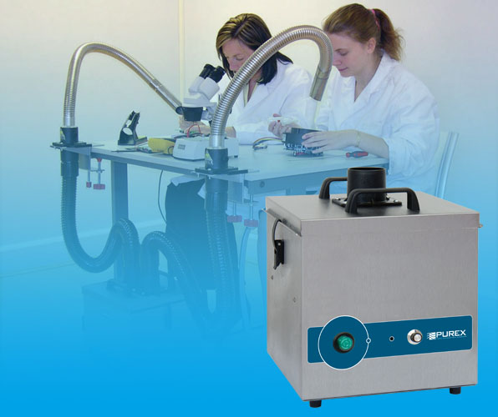
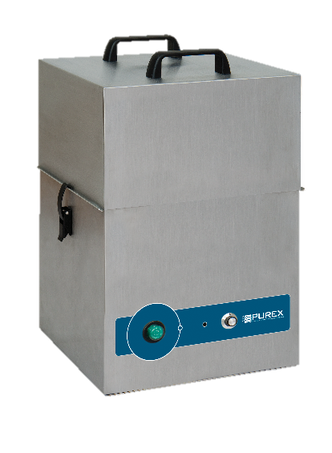
Applications
Hand Solder Key Questions:
How many arms/soldering stations?
What type of material is being used?
Selective Solder Key Questions:
What type of material is being used?
Required airflow?
Number of exhaust ports in oven?
Size of exhaust ports?
Click here to view the Purex Application Questionnaire

Slide 27
Applications
Laser Depaneling Key Questions:
What type of material is being used?
Laser Marking Key Questions:
What substrate is being marked?
Conformal Coating Key Questions:
Required airflow?
Which materials? (SDS sheets if available)
Click here to view the Purex Application Questionnaire

Slide 28
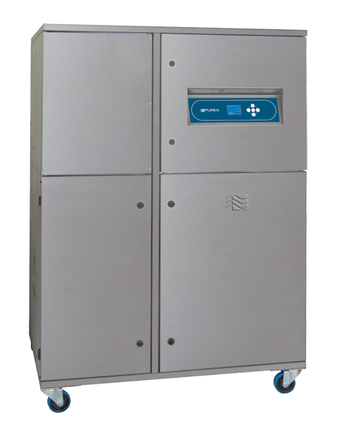
Applications
Reflow Oven Key Questions:
Required airflow?
Number of exhaust ports in oven?
Size of exhaust ports?
Type of solder used? (SDS sheet if available)
Wave Solder Key Questions:
Required airflow?
Number of exhaust ports in oven?
Size of exhaust ports?
Type of solder and flux used? (SDS sheet if available)
Click here to view the Purex Application Questionnaire

Slide 29
Questions?
3651 Walnut Avenue
Chino, CA 91710 USA
(909) 664-9980
Service@APR-Rework.com

